Slide 1
Worldwide Turbines
COMPANY
PRESENTATION

Slide 2
Previous History…
1983 Started Jet Turbine Service (JTS)
1995 JTS sold to Volvo
1995 JTS transforms from a aviation parts company to an aeroderivative energy parts company
1996 Established a Joint Venture with Airwork in the repair and overhaul of Pratt and Whitney GG4 engines.
1998 Consolidated the engine and free-turbine repair in Florida.

Slide 3
Previous History… Con’t
1999 Hired local FAU university students as
co- ops to help build our business.
2000 Established JTS-Jacksonville, Inc. and leased test cell and jet maintenance facilities in Jacksonville, FL from U.S. Navy
2001 Established engine testing overhaul capability and field service base in Jacksonville.

Slide 4
Previous History... Con’t
.
2001 Established in-house fuel manifold repair capabilities.
2003 Launched the GE LM Division.
2004 Sold largest independent aeroderivative company to Siemens

Slide 5
Our History…
2007 Worldwide Turbines founded.
2008 to 2010 Focused on sale of parts
2008 Formed a Joint Venture with Premier Turbines (GG4 engine overhaul)
June/2010 Purchase fuel bench and set up fuel systems in Massachusetts
OCT/2010 Purchased Premier Turbines
GG4 Assets

Slide 6
Our History…. Con’t
Oct –Nov 2010 Relocated From Neosho, Missouri
to Millville , NJ
Dec 2010 Set up Free Turbine Shop
January 2010 Completed in-house test cell

Slide 7
Organization Chart
PRESIDENT
PETER LOBELLO JR..
FLORIDA
Business Development
Peter LoBello Sr.
FLORIDA
Controller
John Damian
MASSACHUTES
Field Service
Ken Trombley
New Jersey
Sales
Joe Lang
New Jersey
Quality Control
Andy Luko
New Jersey
Engineering
Jack McGroarty

Slide 8
Worldwide Services…
Component Replacement
Consignments
Controls
Engine Sales and Leasing
Engine and Free TurbineTesting
Field Services
Fuel Systems
Maintenance
Maintenance Contracts
Module Exchange
Overhauls
Parts (OEM and Re-Engineered)
Site Review & Audits

Slide 9
Current Capabilities…
Complete Overhaul/Hot Section of GG4A &C Type Gas Generator and Free Turbine:
Tooled for complete engine overhaul
Tooled for overhaul of Free Turbine
Extensive Parts and Rotables Inventory
Mechanic training program
Rotor Balance
Hot Section Kits and Exchange
Fuel Nozzle and Manifold Repair / Overhaul
Engine Sales and Leasing
Complete Engine Testing
Site Audits and Boroscope

Slide 10
Other Capabilities
Hot Section Inspection of FT8
Minor shop repair of FT8 and LM2500
Field Service of all aeroderivative engines
Complete overhaul of JT4
Over 100,000 sq. ft. of under roof storage space.
Spin test Free Turbines

Slide 11
2013 – 2015 Major Projects…
Completed liquid to dual fuel conversion with Con Ed
Complete restoration of FT4A-11 failure in Ecuador
Increase our pool of spare engines and rotables
Completed FPL engine overhaul project
Entered Latin America Business
Repaired, overhauled and tested over 100 FT4’s and earned over 50 % of repair market share.

Slide 12
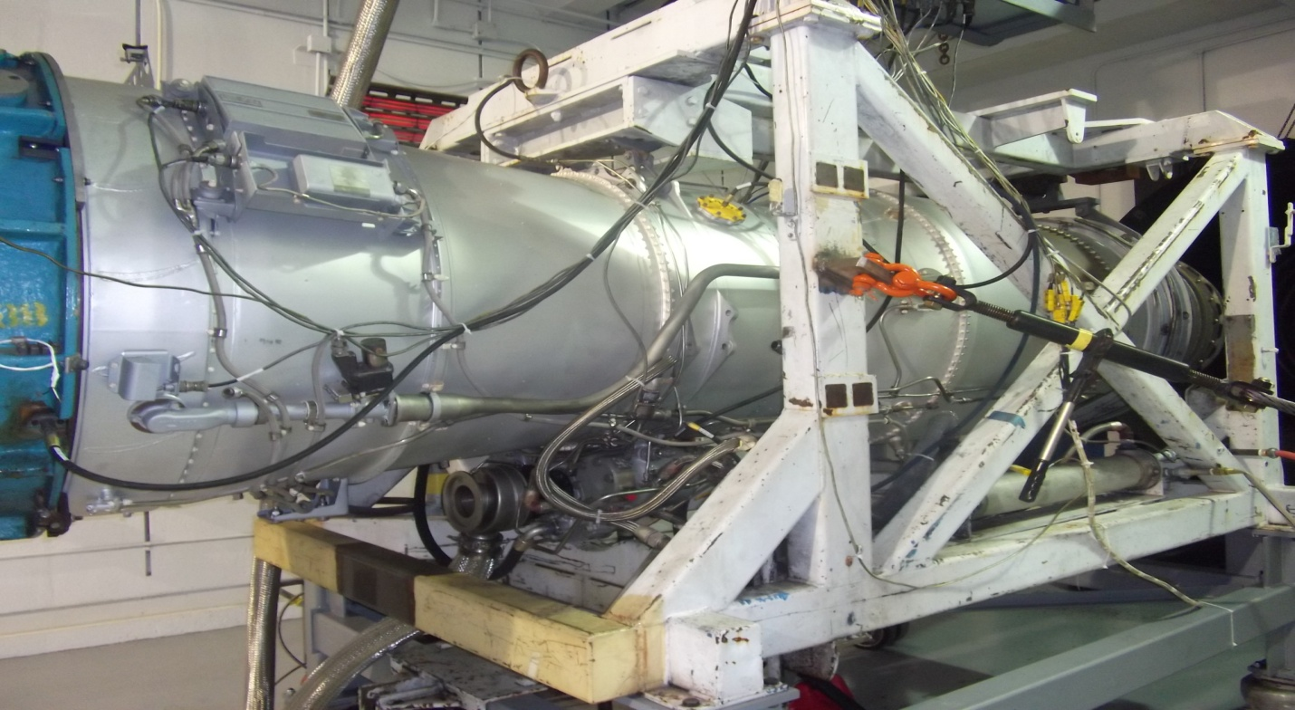
Engine Test Cell

Slide 13
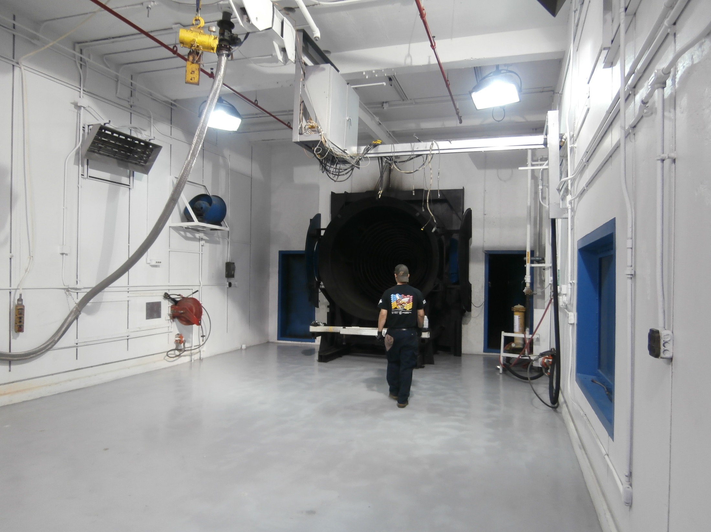

Slide 14
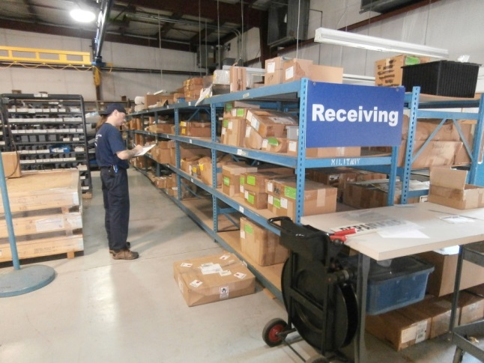

Slide 15
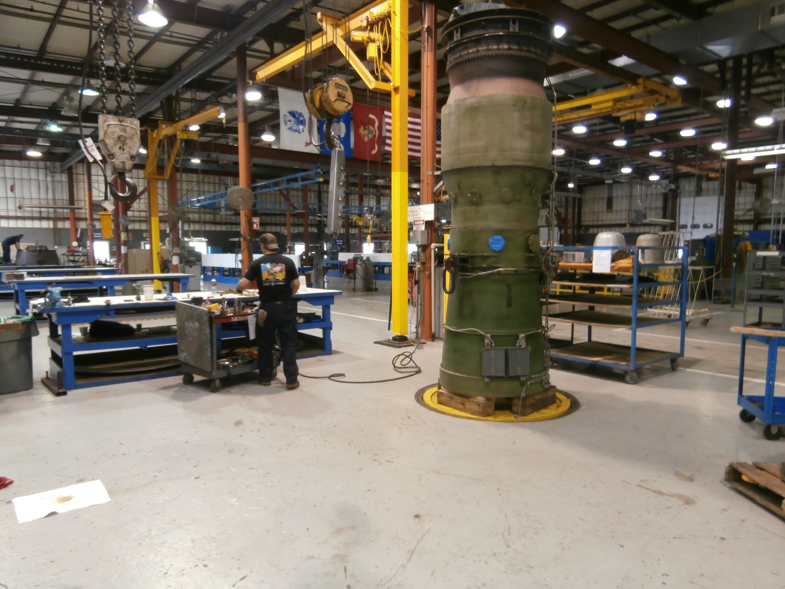

Slide 16
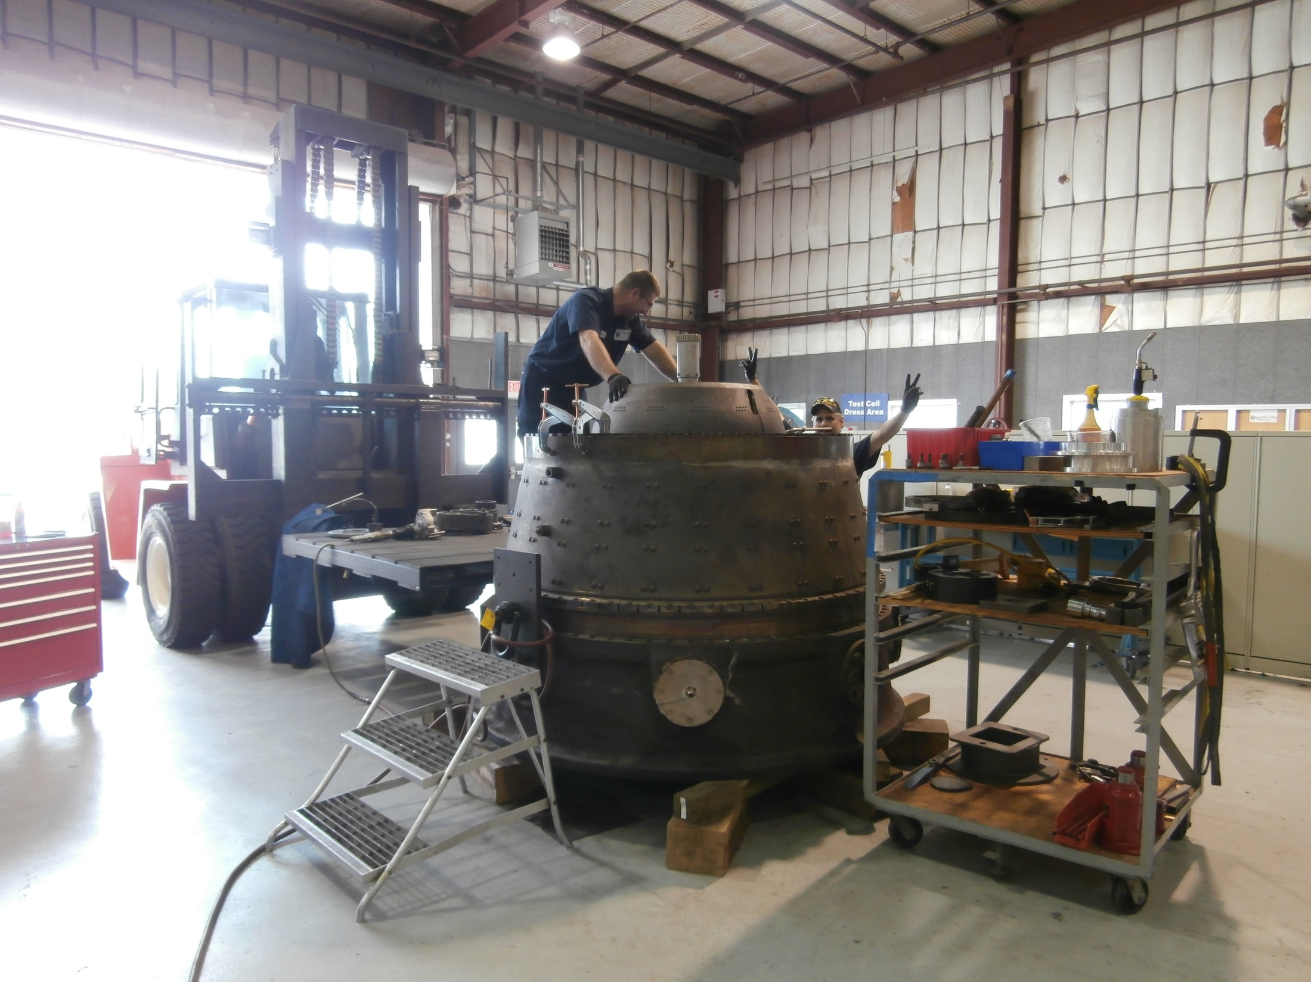

Slide 17
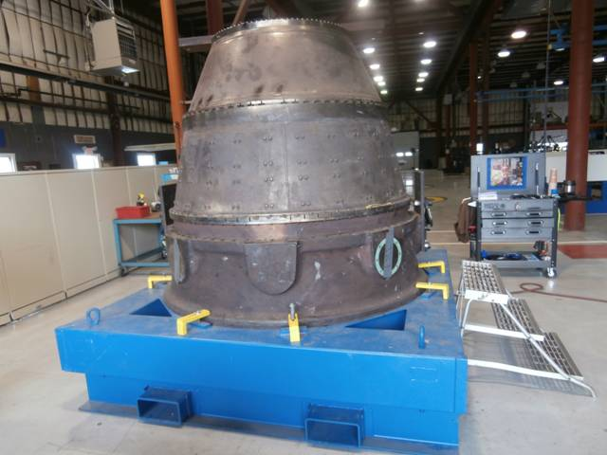

Slide 18
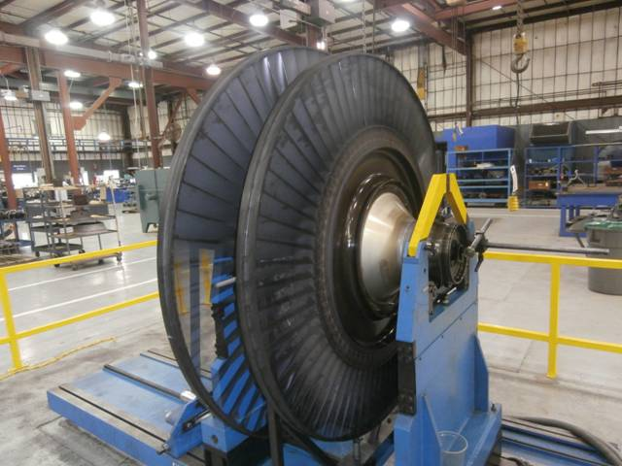

Slide 19
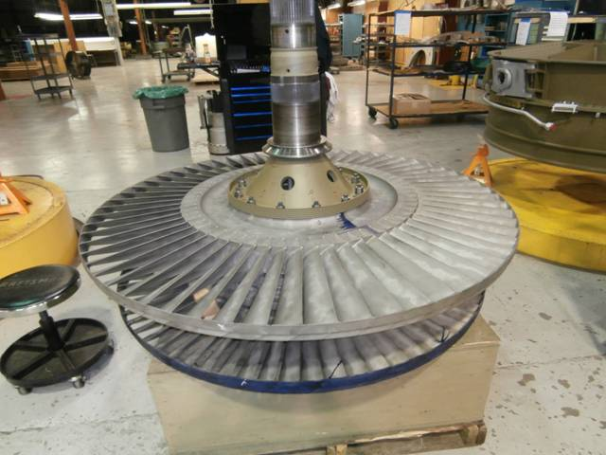

Slide 20
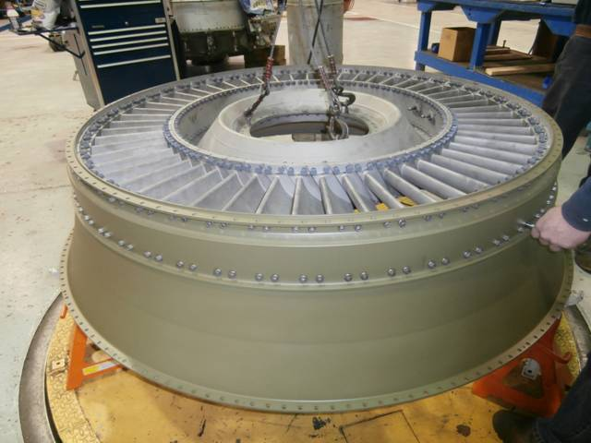

Slide 21
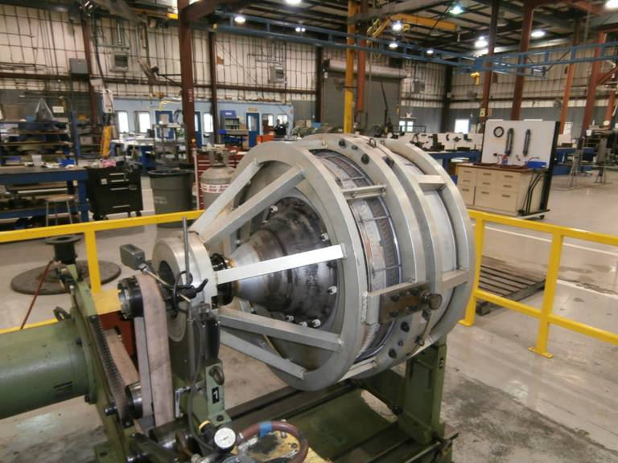

Slide 22
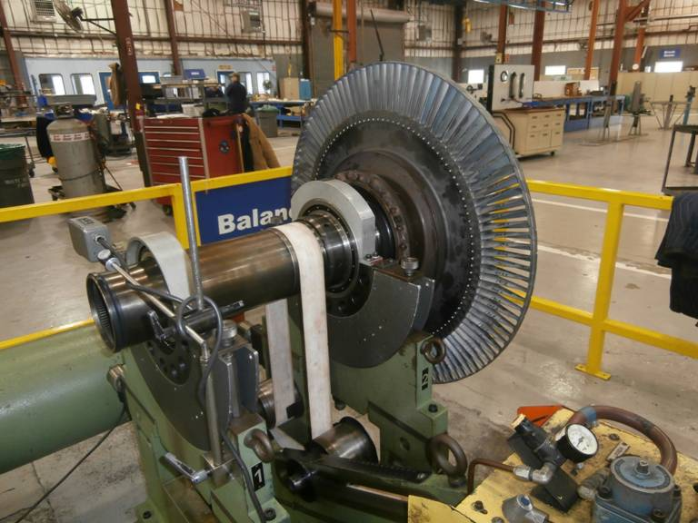

Slide 23
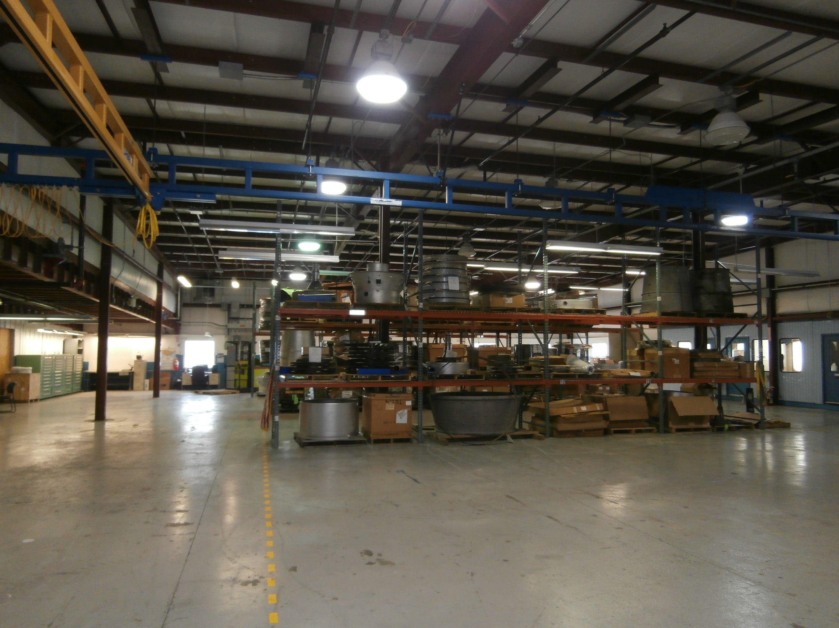

Slide 24
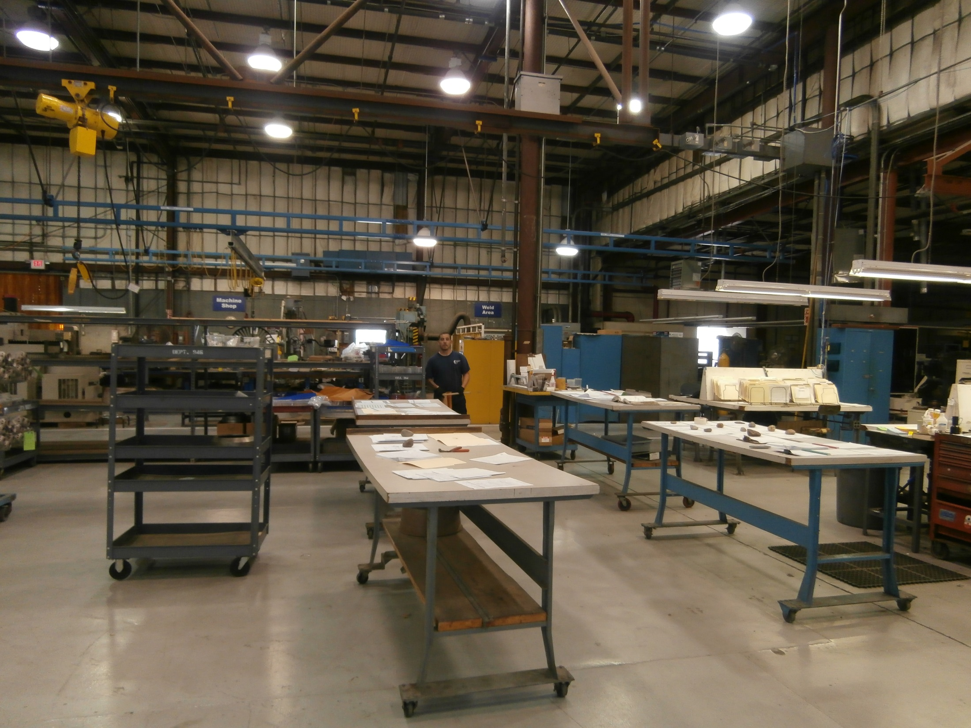

Slide 25
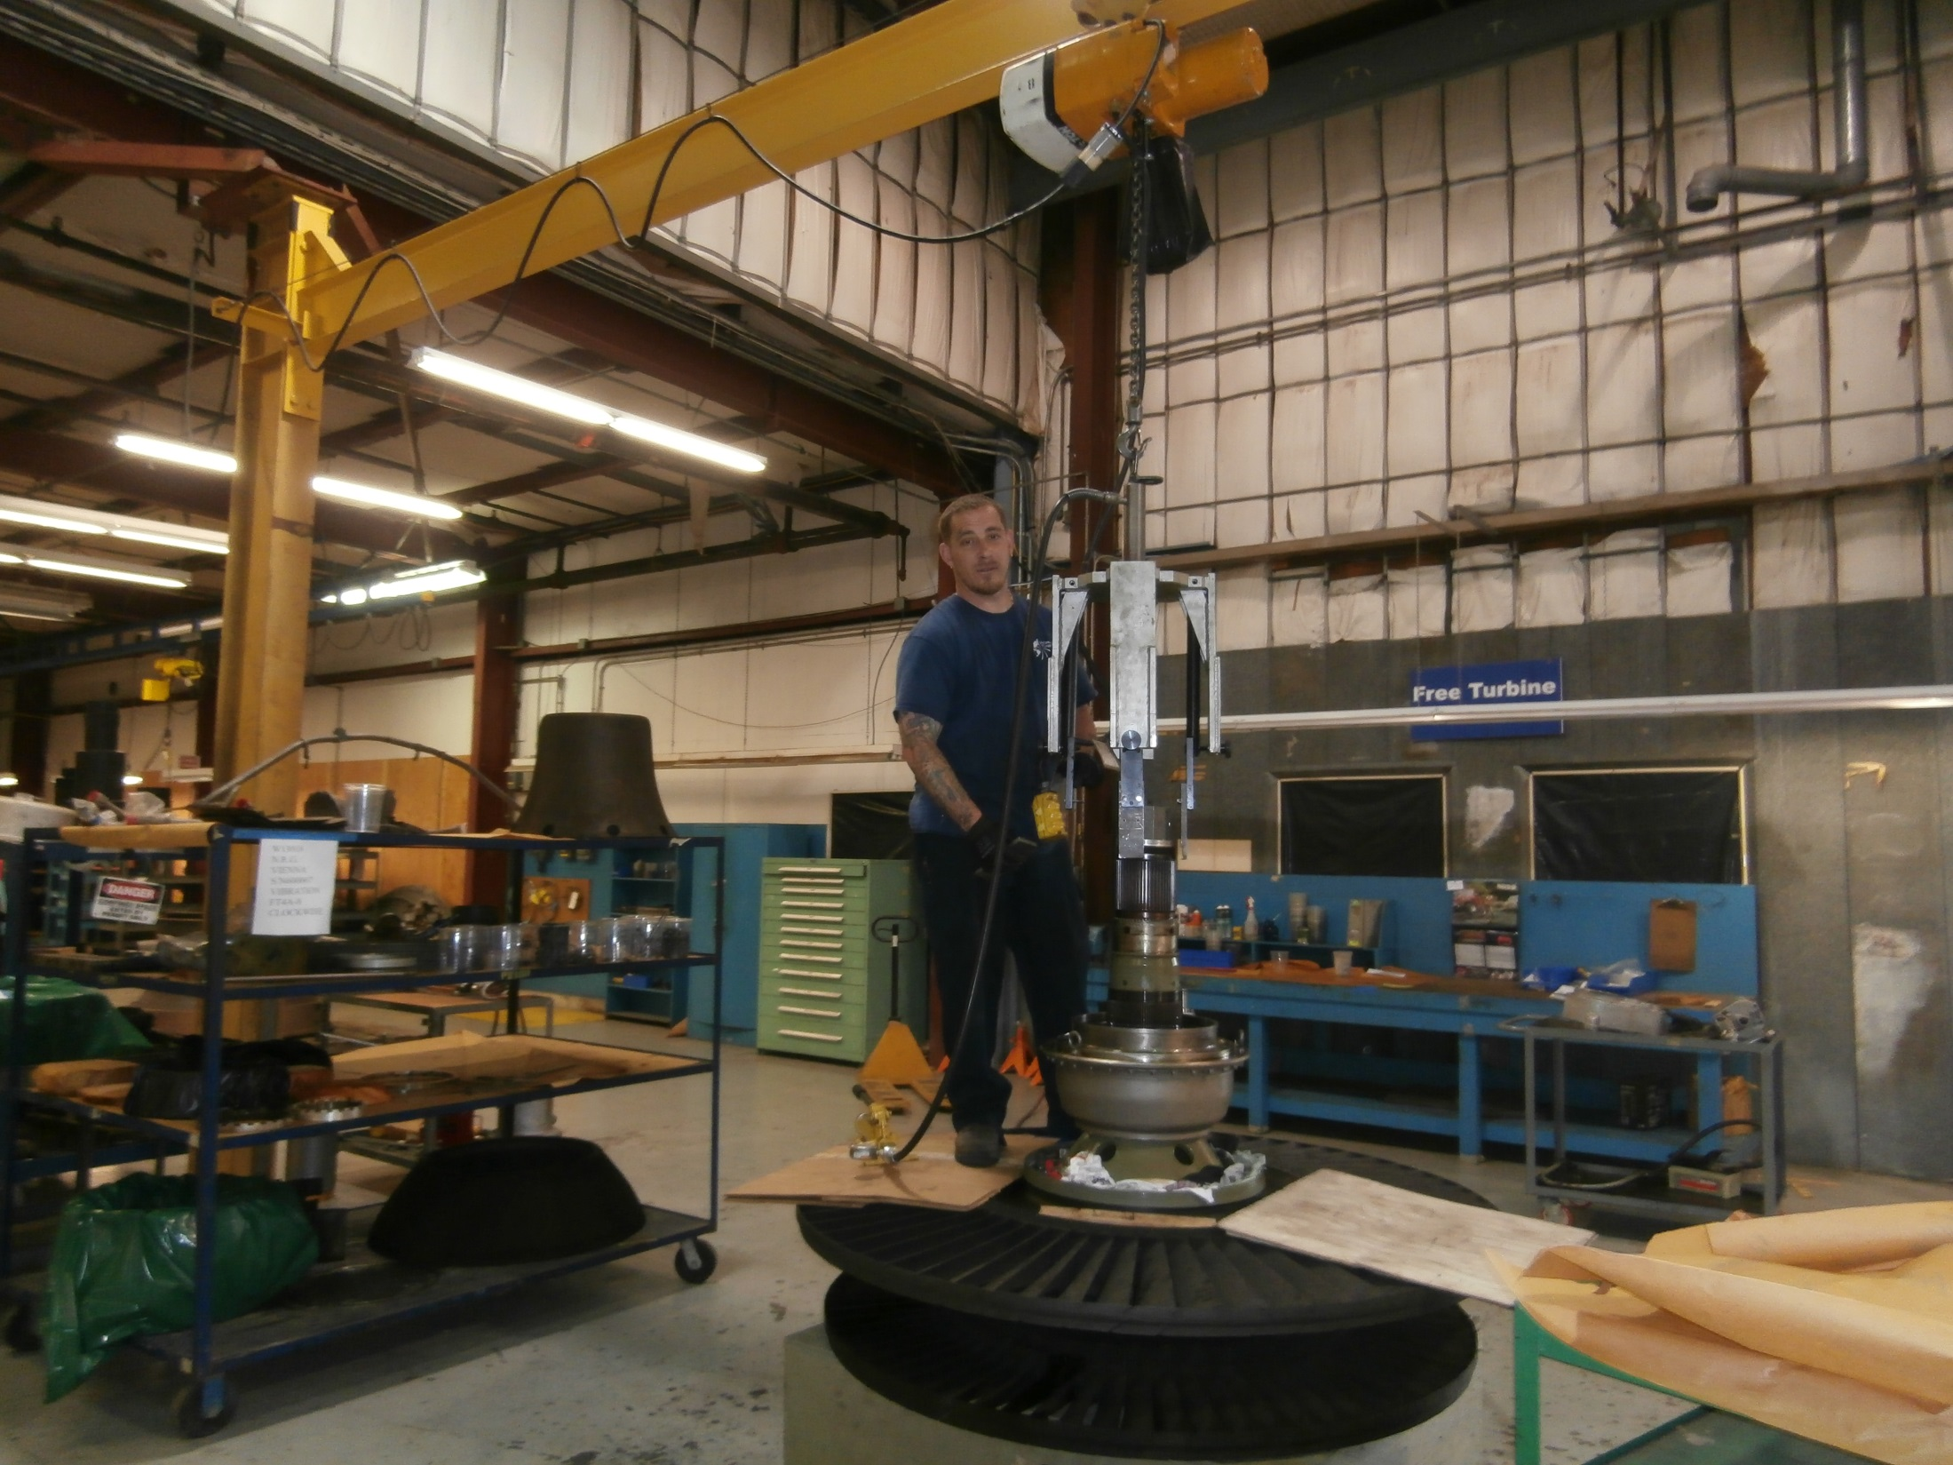

Slide 26
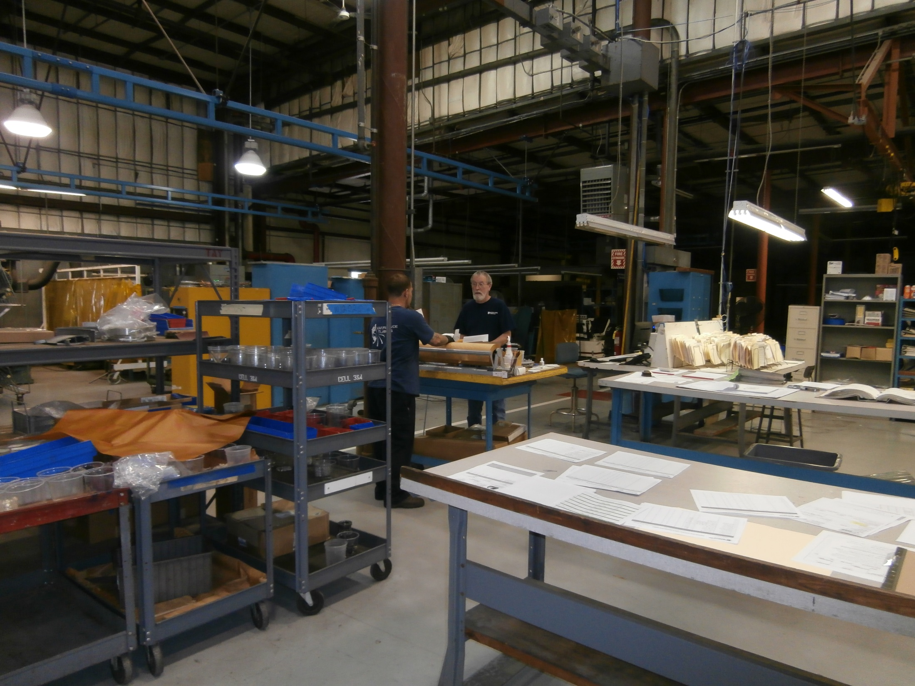

Slide 27
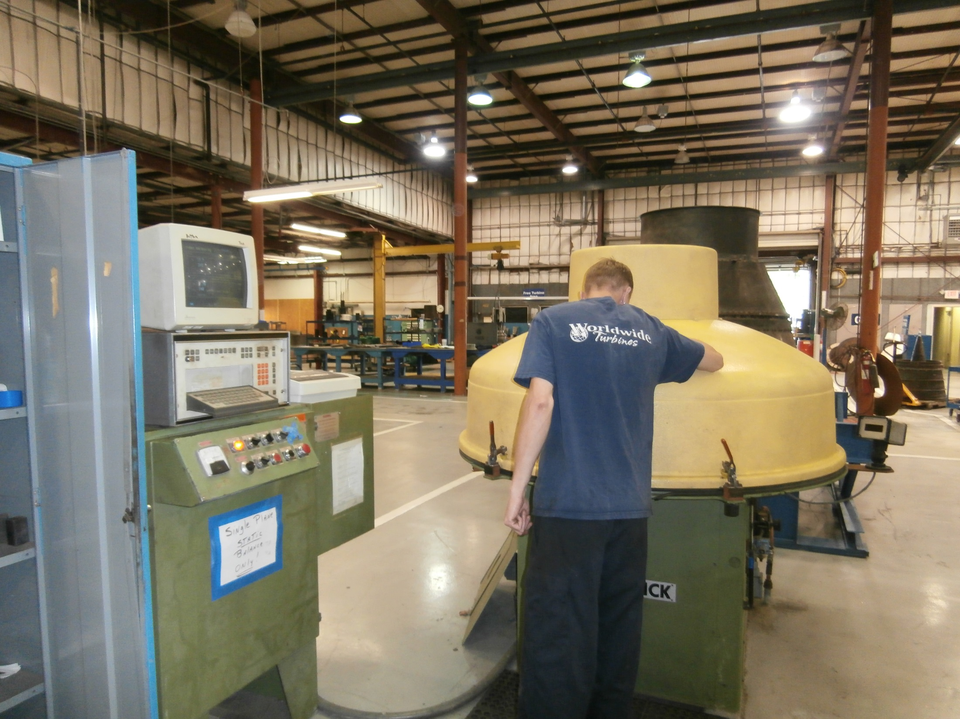

Slide 28
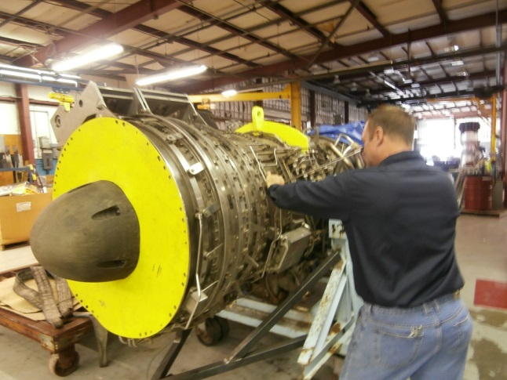

Slide 29
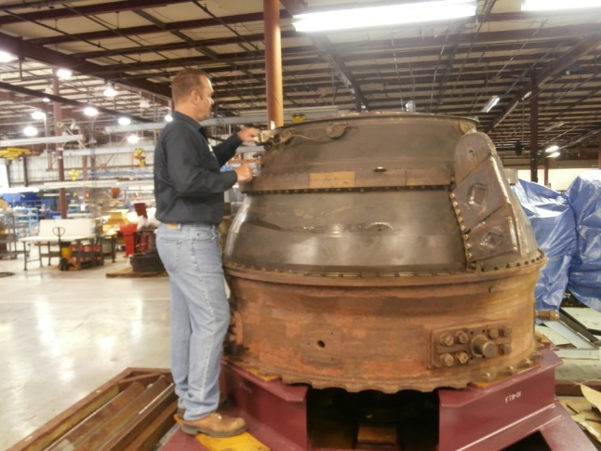

Slide 30
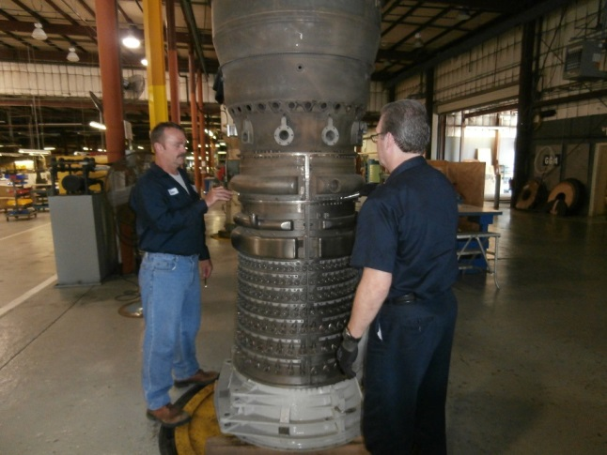

Slide 31
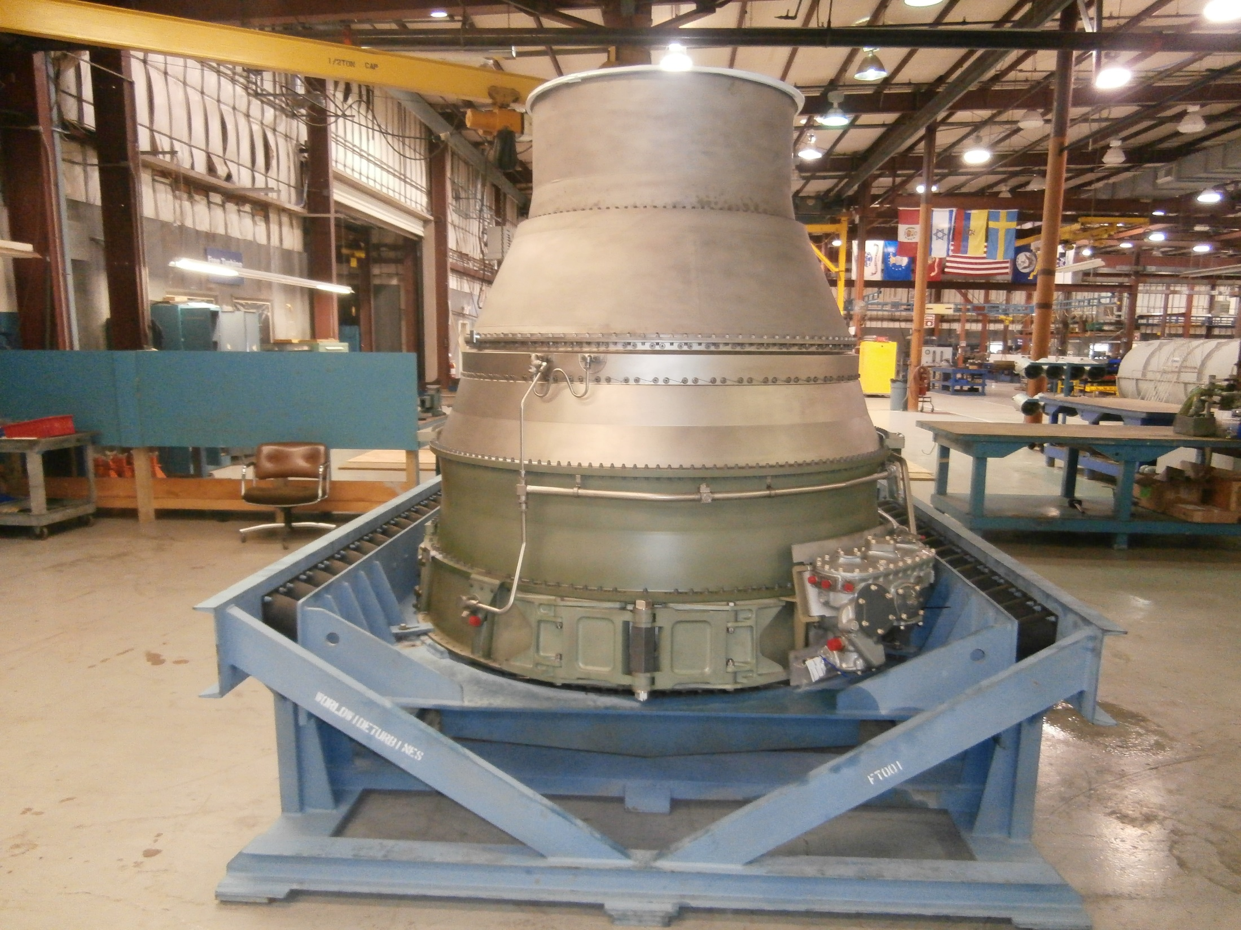

Slide 32
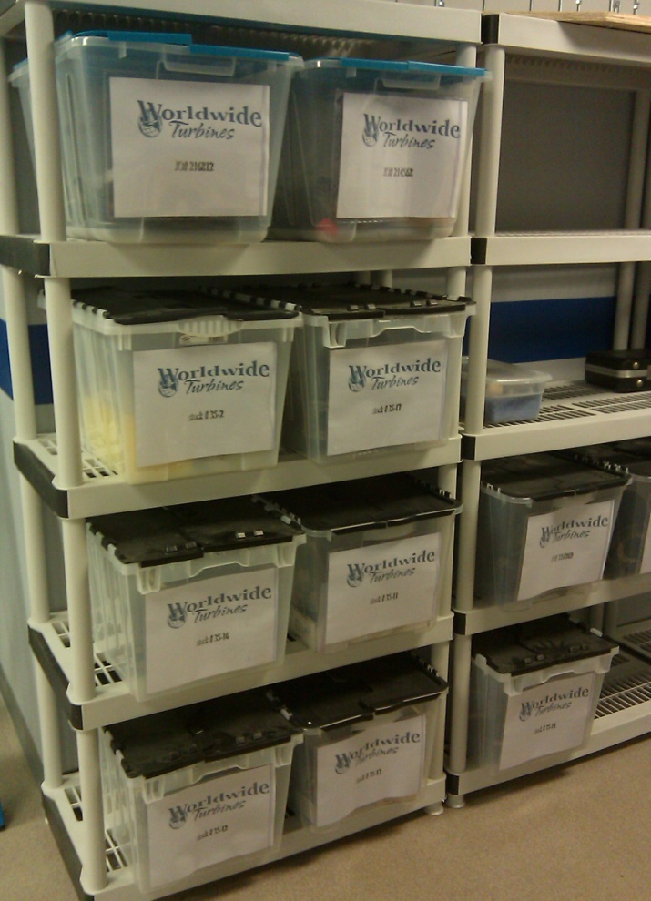
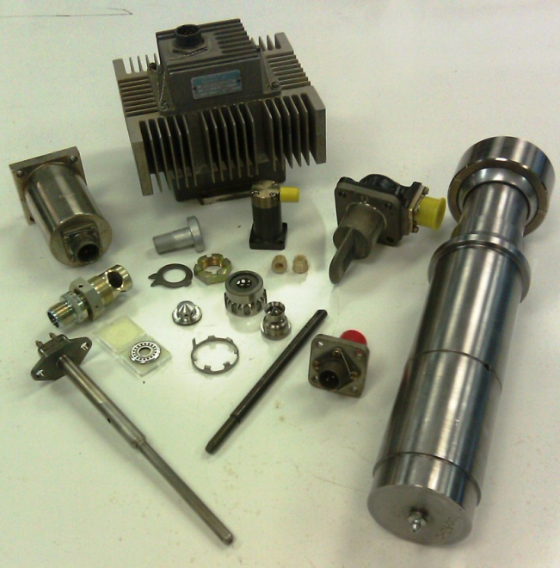

Slide 33
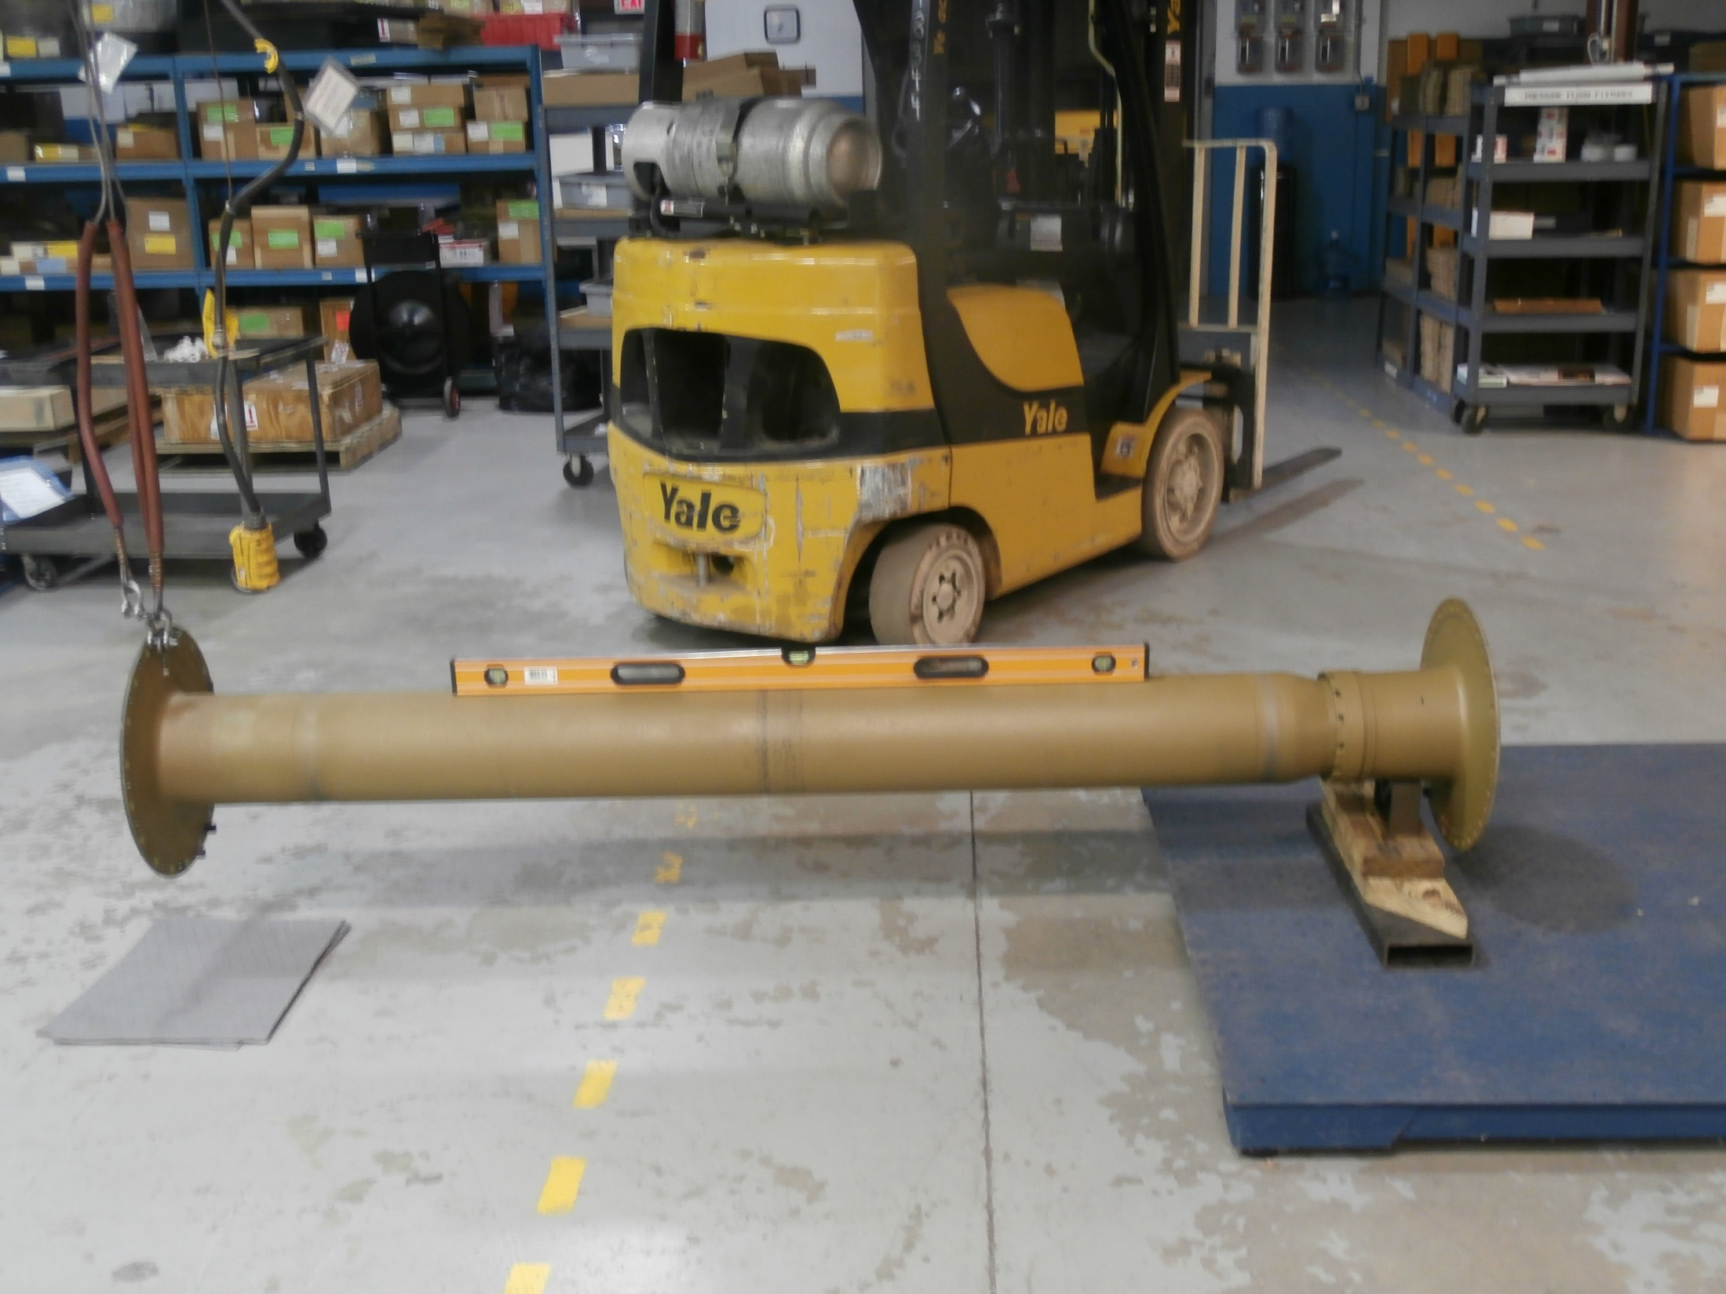

Slide 34
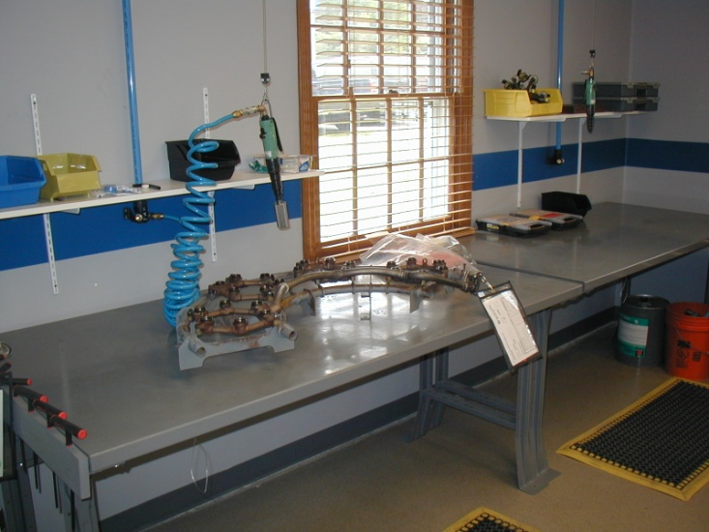
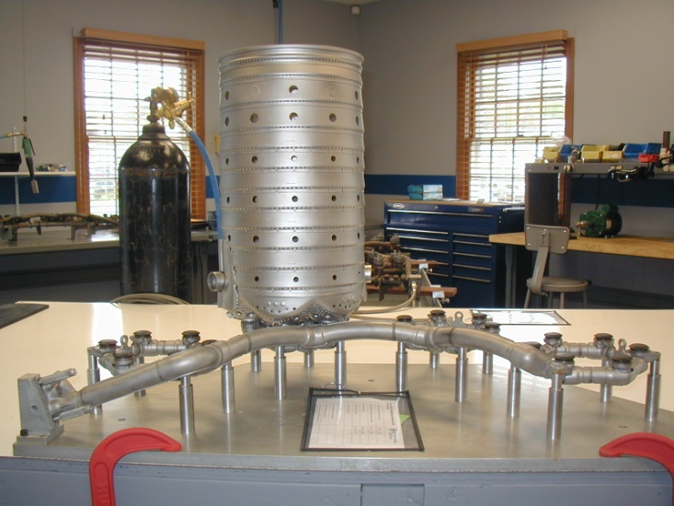
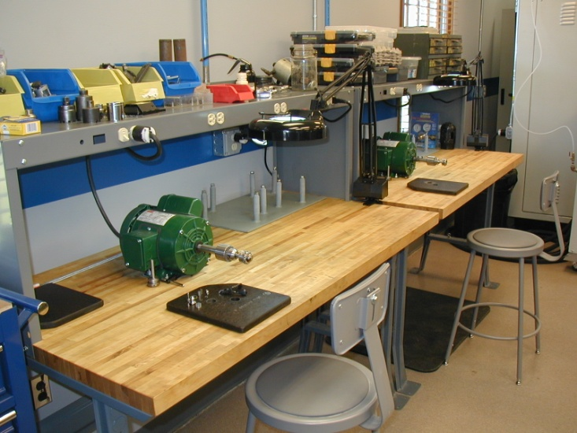
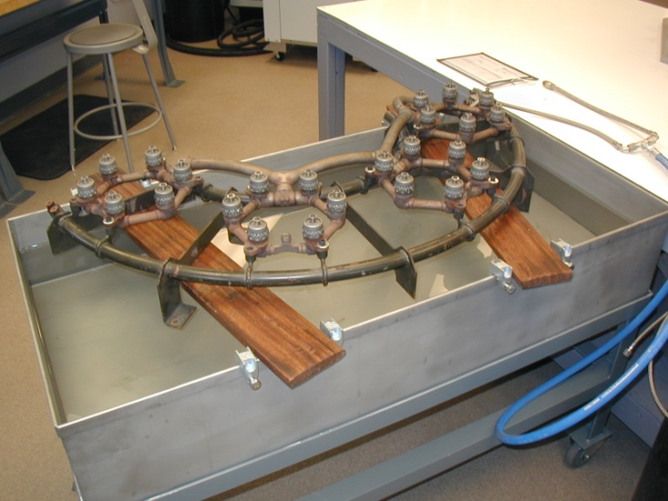
Complete
Manifold and Nozzle Overhaul Facility

Slide 35
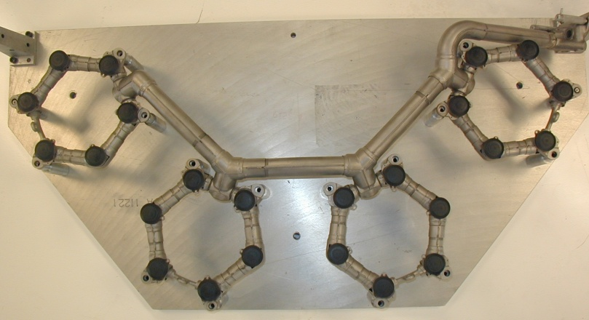
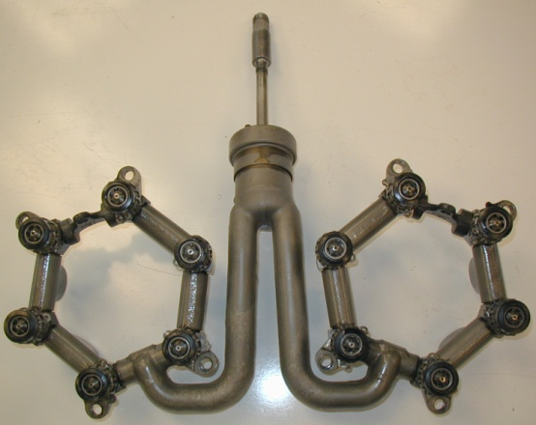
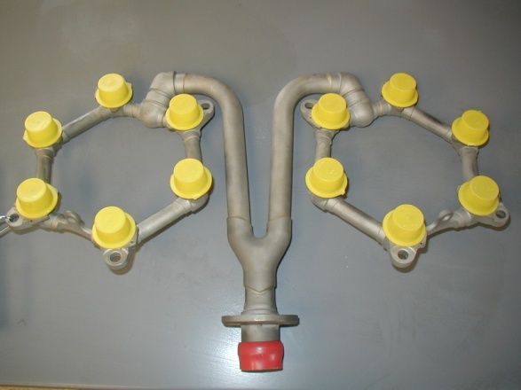
GG4A/C Liquid Fuel Manifold Assembly
18:1 and Airblast (Delavan) type
GG4A/C Dual Fuel Manifold Assembly
Parker Hannifin and Airblast (Delavan) type
GG4A/C Gas Fuel Manifold Assembly

Slide 36
Comprehensive Machine Shop
CNC Bridgeport, lathe, surface grinder, band saw, and more
Manifold adapter replacement on Dual Fuel and Gas manifolds
Liquid inlet tube replacement on Dual Fuel manifolds
Mounting lug and combustion chamber pin hole repair

Slide 37
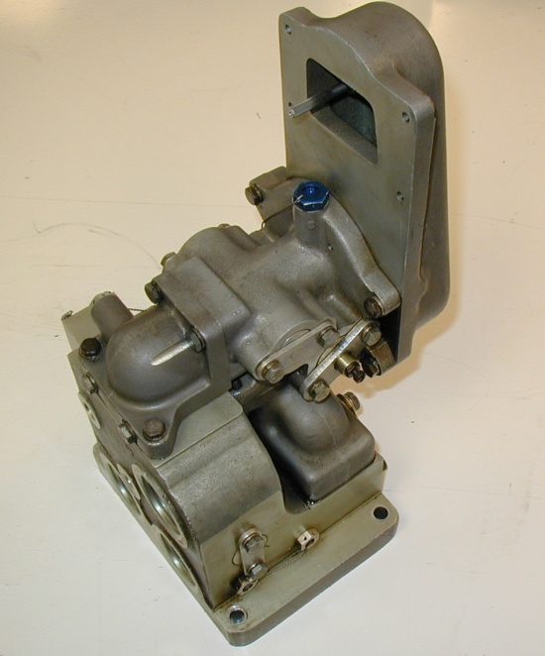
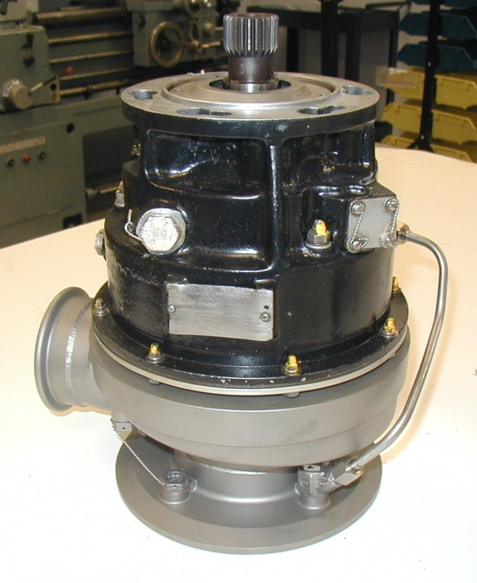
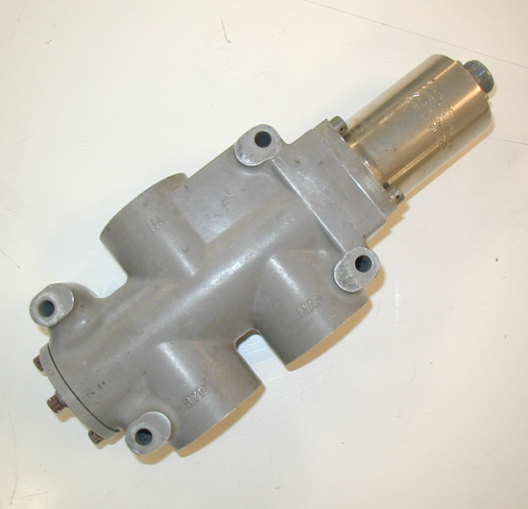
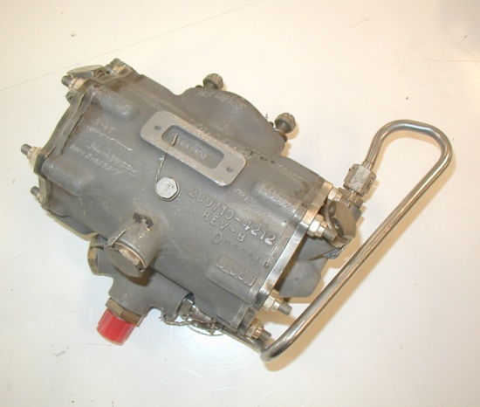
Full Complement of Accessory Repairs
Mod Valve
#2 Shutoff Valve
Bleed Valve
Start Valve
Starter

